Slide 1
Customer Segmentation Analysis

Slide 2
Overview--
This project aims to perform a comprehensive Customer Segmentation Analysis using SQL and Power BI. The analysis focuses on shopping distribution by gender and age, identifying which demographics purchased more products and generated more revenue. Additionally, it examines the distribution of purchase categories relative to other columns and investigates the relationship between payment methods and other variables. The insights derived from these analyses will be visualized and presented with actionable recommendations for the company to optimize their marketing and sales strategies.
Customer segmentation analysis

Slide 3
Objective--
Task:
1. How is the shopping distribution according to gender?
2. Which gender did we sell more products to?
3. Which gender generated more revenue?
4. Distribution of purchase categories relative to other columns?
5. How is the shopping distribution according to age?
6. Which age cat did we sell more products to?
7. Which age cat generated more revenue?
8. Distribution of purchase categories relative to other columns?
9. Does the payment method have a relation with other columns?
10. How is the distribution of the payment method?
11. Visualize the data using Tableau /PowerBI and derive
insights and give your inputs/suggestions to the company.

Slide 4
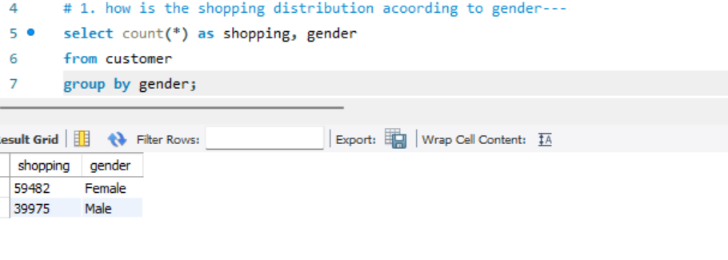
1. How is the shopping distribution according to gender?
The purchase data shows that females made 59,482 purchases, while males made 39,975. Females account for about 59.8% of the total purchases, with males at 40.2%. This indicates females are more active purchasers in this dataset. This insight can guide targeted marketing and inventory strategies.

Slide 5
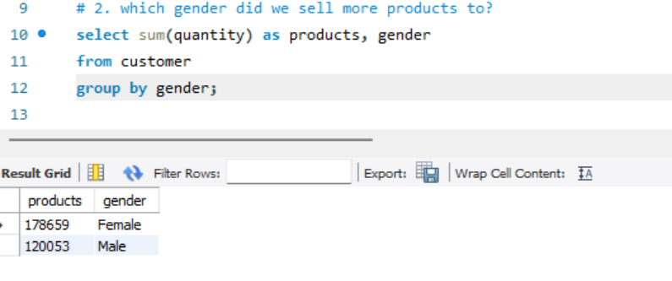
2. Which gender did we sell more products to?
2.The data indicates that females bought 178,659 products, while males bought 120,053. Females account for 59.8% of the total products sold, and males for 40.2%. This highlights a higher purchasing volume among females. Such insights can inform targeted marketing and inventory decisions.

Slide 6
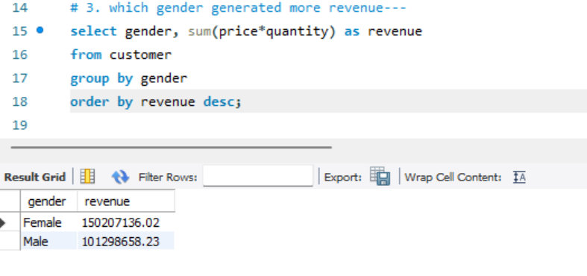
3. Which gender generated more revenue?
. The data indicates that males generated a total revenue of \$101,298,658.20, while females generated \$15,020,713. Despite females having higher purchase counts and total products sold, males contributed significantly more to the total revenue. This suggests that males may be purchasing higher-value items compared to females. These insights could help in tailoring pricing strategies and product offerings.

Slide 7
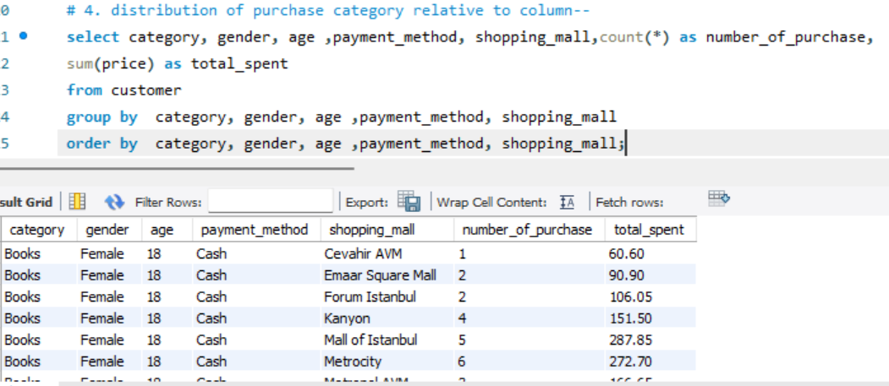
4. Distribution of purchase categories relative to other columns?
. Clothing is consistently the most purchased category across these top age groups, highlighting its universal appeal.
• Food & Beverage and Cosmetics are also highly popular, suggesting that these age groups value both appearance and lifestyle experiences.
• The 22 and 24 age groups have very similar purchasing patterns, focusing on fashion and social activities, while the 37 age group shows continued interest in these areas, potentially reflecting a more established lifestyle with similar interests

Slide 8
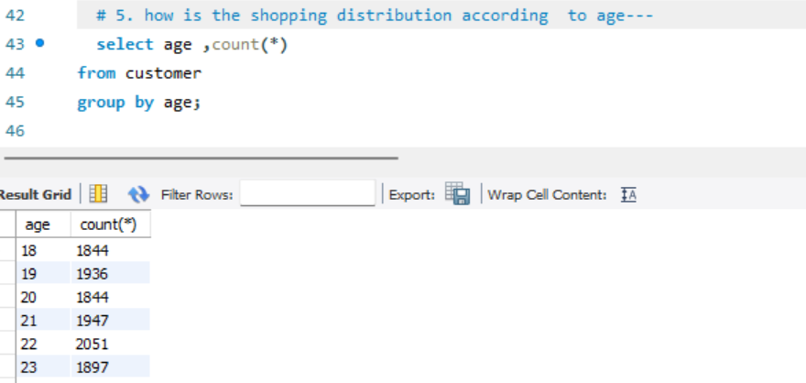
5. How is the shopping distribution according to age?
. Females lead in total purchases across all categories, with the most significant differences seen in Clothing and Cosmetics.
• Males also show strong engagement, especially in Clothing, Cosmetics, and Food & Beverage.
• These insights can guide targeted marketing strategies, with a focus on fashion and beauty products for females and expanding male-oriented marketing in cosmetics and food & beverage sectors.

Slide 9
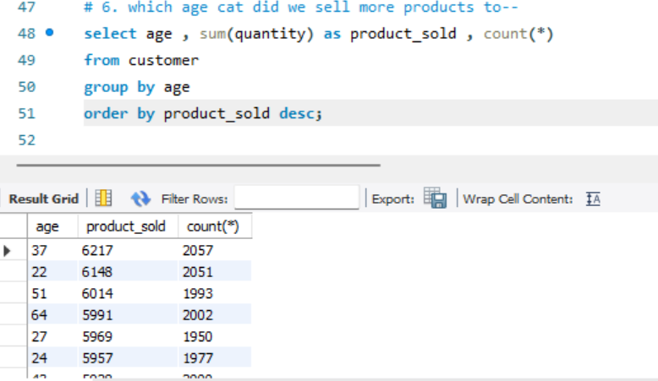
6. Which age category did we sell more products to?
The total products sold to
each age category are as follows:
0-20 years: 16,801 products
21-30 years: 58,371 products
31-40 years: 57,850 products
41-50 years: 57,156 products
51-60 years: 56,997 products
61-70 years: 51,537 products
The age category 21-30 years
had the highest total number of products sold,
with 58,371 products. ​​

Slide 10
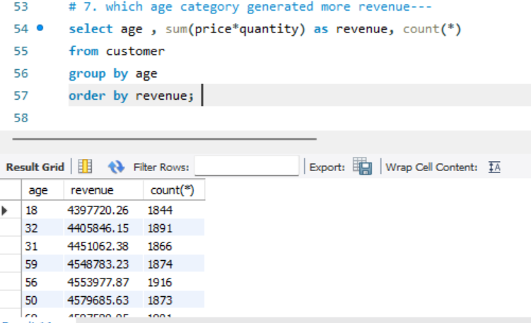
7. Which age cat generated more revenue?
. Age 37 leads with the highest purchase count, reflecting possibly higher disposable income and diverse interests.
• Age 22 and 24 follow closely, highlighting strong engagement with fashion and lifestyle products.
• These insights can help in tailoring marketing strategies to target these age groups effectively, focusing on their preferred categories such as Clothing, Food & Beverage, and Cosmetics

Slide 11
8. Distribution of purchase categories relative to other columns?
. Age 37 leads in total products sold, indicating high engagement across a variety of categories.

Slide 12
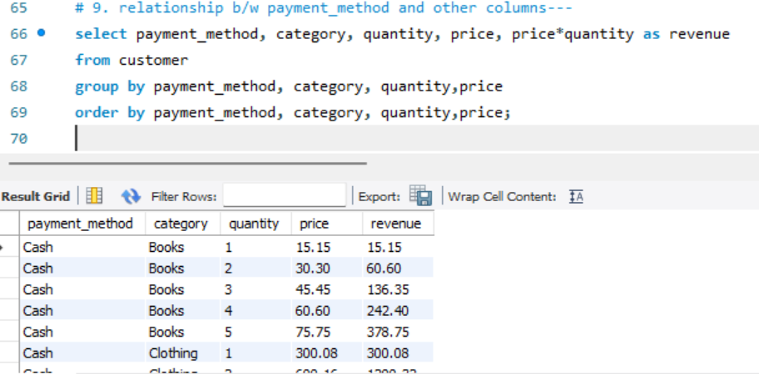
9. Does the payment method have a relation with other columns?
. Females lead in all payment methods, with 26,509 cash transactions, 21,011 credit card transactions, and 11,962 debit card transactions. Males follow with 17,938 cash transactions, 13,920 credit card transactions, and 8,117 debit card transactions. This indicates a higher overall purchasing activity among females across all payment modes.

Slide 13
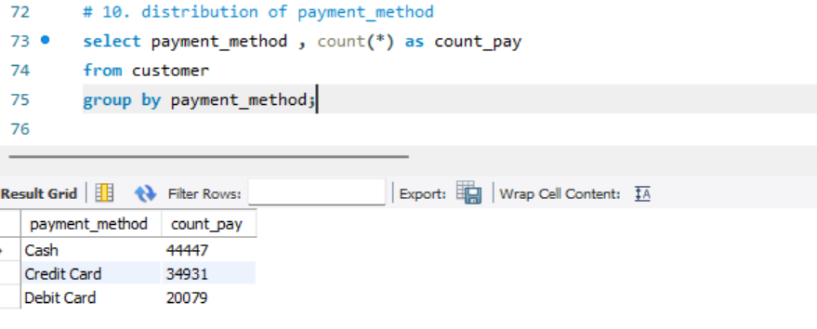
10. How is the distribution of the payment method?
. The overall payment method distribution shows that cash is the most preferred with 44,447 transactions, followed by credit cards with 34,931 transactions, and debit cards with 20,079 transactions. This indicates a strong preference for immediate cash payments among consumers, with credit cards being the second most popular method.

Slide 14
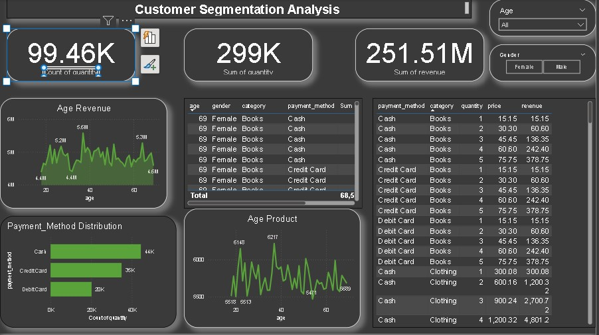
11. Visualize the data using Power BI and derive insights and give your inputs/suggestions to the company.

Slide 15
INSIGHTS---
1. Target Marketing:
• For Females: Focus on fashion, beauty, and lifestyle products. Emphasize clothing and cosmetics, and consider campaigns around food and beverage offerings.
• For Males: Highlight clothing and grooming products, while also promoting food and beverage options.
2.Age-Specific Strategies:
• Age 37: Diverse product offerings, including high-value items, to appeal to their broad interests and higher disposable income.
• Age 22 and 24: Focus on trendy, fashionable, and lifestyle-enhancing products. Engage them with dynamic marketing campaigns.
• Age 51 and 64: Emphasize quality, reliability, and premium products, particularly those related to lifestyle and health.
3.Payment Method Optimization:
• Cash Transactions: Ensure smooth and efficient cash handling processes in physical stores, given its popularity.
• Credit Card Promotions: Offer incentives like rewards or discounts for credit card users to increase their engagement.
• Debit Card Convenience: Improve ease of debit card transactions and consider special offers to encourage more usage.

Slide 16
. 4. Cross-Selling and Up-Selling:
• High-Spending Age Groups: Implement strategies to cross-sell and up-sell to age groups 37, 22, and 51, who show high engagement and revenue generation.
• Product Bundling: Create attractive bundles combining popular categories such as clothing with cosmetics or shoes to boost sales.
5. Customer Experience Enhancement:
• Personalized Marketing: Use data to personalize marketing efforts, ensuring that promotions and recommendations are tailored to individual preferences and shopping behaviours.
• Loyalty Programs: Develop robust loyalty programs that reward frequent shoppers, particularly focusing on the high-spending
# By implementing these strategies, businesses can better cater to their diverse customer base, enhancing satisfaction and driving sales growth across different segments.

Slide 17


